Slide 1

DBMS PROJECT
Database Management Systems (2501IT05)
UNIVERSITY MANAGEMENT SYSTEM
Project Guide: PARASA KEERTHANA Mam
TEAM MEMBERS:
25B11DS045 - B.ROHITH
25B11DS286 - K.ANANDH SAI
25B11DS331 - M.GOWRI SHANKAR
25B11DS034 - Ayush Kumar Singh
25B11DS211 - K.SIVA LAKSHMI RAHUL

Slide 2



Project Overview
INTRODUCTION
Problem
Solution
Why It Matters
Managing student, faculty, course, enrolment, and academic records manually can be complex, time-consuming, and prone to errors.
A centralized MySQL-based University Management System that organizes academic data using related tables, keys, constraints, and relationships.
The system reduces data redundancy, improves data consistency, maintains relationships between records, and enables efficient access to university information.
2

Slide 3

Project Objective
INTRODUCTION
Main Goal
Centralize Data: Design a relational database to organize university academic and administrative data.
Identify Entities: Define the major entities such as College, Department, Student, Faculty, Course, and Enrolment along with their attributes
Define Relationships: Establish meaningful relationships between entities using appropriate cardinalities.
Ensure Data Integrity: Define Primary Keys and Foreign Keys to uniquely identify records and maintain referential integrity.
Prepare Database Schema: Convert the ER model into a structured relational schema suitable for implementation as a relational database.
3

Slide 4
What We Found
DATABASE DESIGN APPROACH
1
Structured Data
University information can be organized into related entities such as College, Department, Student, Faculty, Course, and Enrolment.
2
Reduced Redundancy
A well-designed relational database organizes data into separate related tables, reducing unnecessary duplication and making records easier to maintain.
3
Data Integrity
Keys establish relationships between tables and help maintain consistency and accuracy of university records.
Key Insight
A well-structured database makes university data organized, consistent, and easy to manage.
4

Slide 5

Entity Descriptions
College: Represents the university/institution. Attributes include CollegeID, CollegeName, Address, ContactInfo, EstablishedDate.
•Department: Represents an academic division within a college. Attributes include DepartmentID, DepartmentName, HeadOfDepartment, Location, Contact.
•Student: Stores student information. Attributes include StudentID, Name, Email, Phone, Gender, AdmissionDate, Status, DepartmentID.
•Faculty: Stores faculty information. Attributes include FacultyID, Name, Qualification, Experience, Salary, DepartmentID.
•Course: Defines academic courses. Attributes include CourseID, CourseName, CourseCode, Credits, Duration, Prerequisites, DepartmentID.
•Enrollment: Represents a student's registration for a course. Attributes include EnrollmentID, StudentID, CourseID, EnrollmentDate, Grade.
5

Slide 6
Attributes are the individual data fields that describe the properties of an entity in a database.
They act as columns in a table, storing specific information about each record.
ATTRIBUTES
Examples
College: CollegeID, CollegeName, Address, ContactInfo, EstablishedDate
Department: DepartmentID, DepartmentName, HeadOfDepartment, Location, Contact
Student: StudentID, Name, Email, Phone, Gender, AdmissionDate, Status, DepartmentID
Faculty: FacultyID, Name, Qualification, Experience, Salary, DepartmentID
Course: CourseID, CourseName, CourseCode, Credits, Duration, Prerequisites, DepartmentID
Enrollment: EnrollmentID, StudentID, CourseID, EnrollmentDate, Grade
6

Slide 7
Relationships define how entities in a database are connected to each other.
They show how entities are connected and help maintain meaningful relationships between tables.
RELATIONS
Examples from UMS
College → Department
One college can have many departments.
CollegeID in Department is a foreign key referencing College.
Department → Student / Faculty / Course
Each department manages multiple students, faculty, and courses.
DepartmentID in these tables links them to their department. Student → Course (via Enrolment)
Students can enrol in multiple courses, and each course can have many students.
This is a many-to-many relationship handled through an Enrolment table.
7

Slide 8
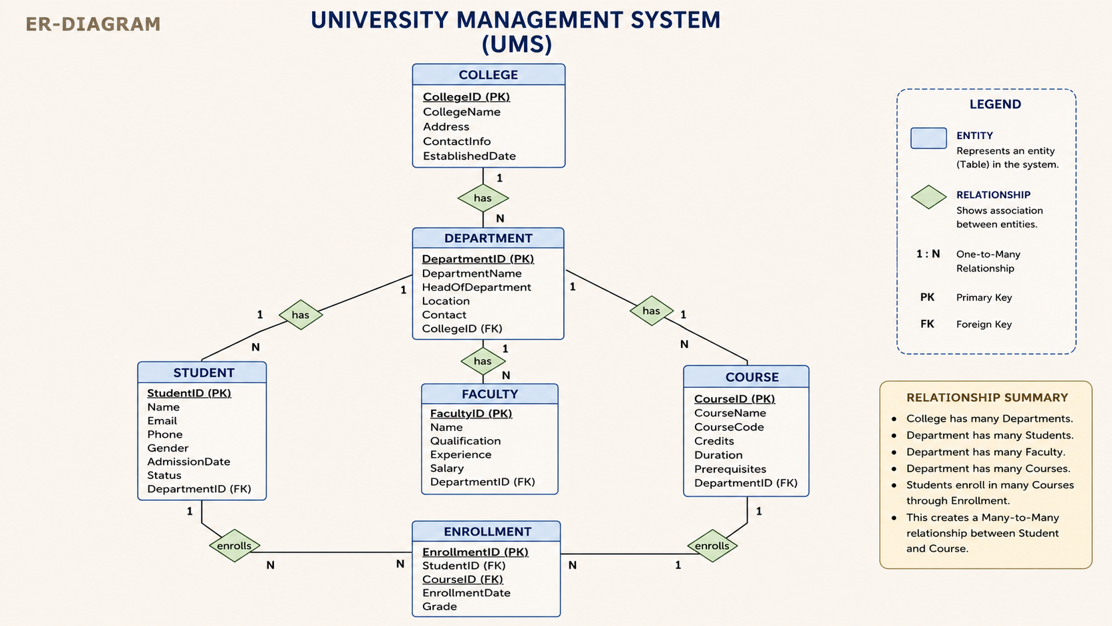
8

Slide 9
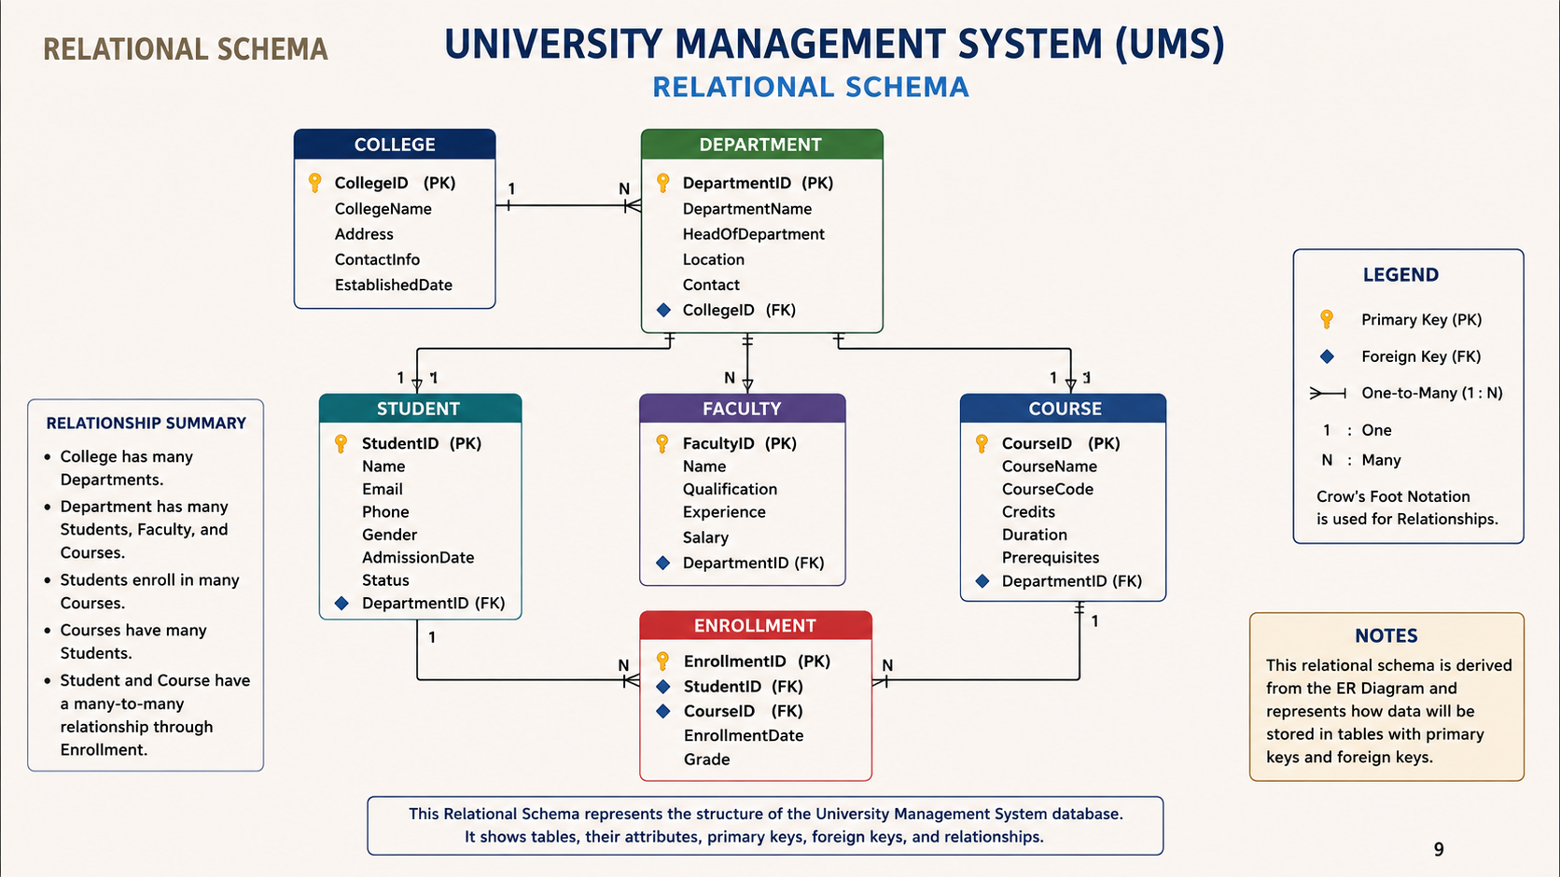

Slide 10
KEY FEATURES
1. Student Management
Store and manage student details
Maintain admission and department information
2. Department & Faculty Management
Manage departments and faculty records
Maintain faculty qualifications and salary details
3. Course & Enrollment Management
Manage courses and prerequisites
Track student course enrollments and grades
4. Database Integrity & Security
Primary and foreign key constraints
NOT NULL and UNIQUE constraints
Role-based access and referential integrity
5. Query & Transaction Support
DML, DQL, DCL and TCL operations
Views and stored procedures
Commit, rollback and savepoint operations
16

Slide 11
FUTURE ENHANCEMENTS
1. Develop a user-friendly web interface for the database system.
2. Provide secure login and role-based access control.
3. Add student performance and attendance tracking.
4. Generate academic and attendance reports.
5. Use data analytics for better academic insights.
6. Improve security, scalability, and data management.
19

Slide 12
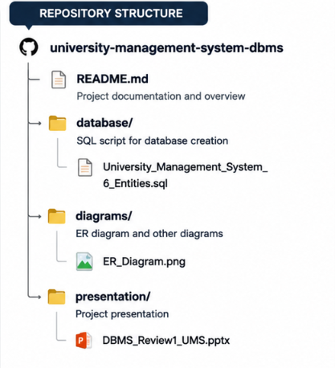
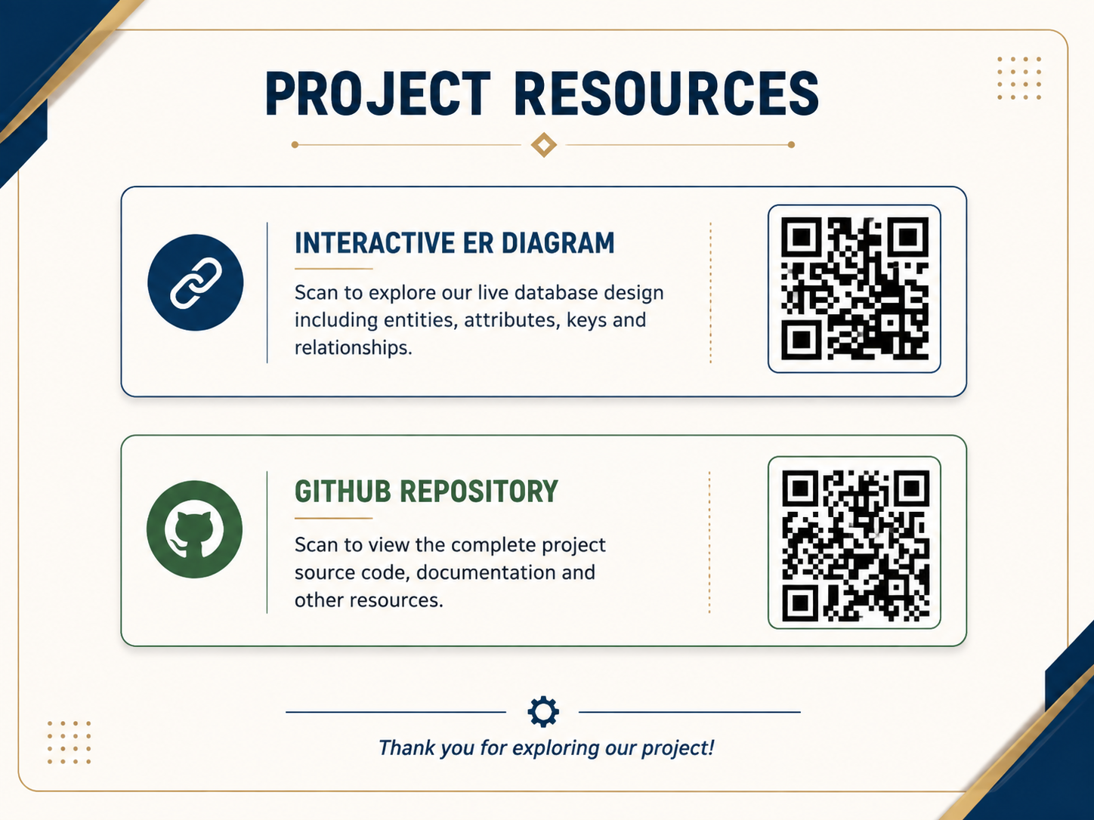
PROJECT RESOURCES & GITHUB REPOSITORY

Slide 13
Thank You
• 25B11DS045 (B. Rohith) – Database Design & College/Department Tables
• 25B11DS286 (K. Anandh Sai) – ER Diagram, Documentation & Presentation
• 25B11DS331 (M. Gowri Shankar) – Faculty & Course Management
• 25B11DS034 (Ayush Kumar Singh) – Attendance & Grade Management
• 25B11DS211 (K. Siva Lakshmi Rahul) – Student & Enrollment Management

